Slide 1
Multiplexers
A multiplexer circuit has a number of data inputs, one or more select inputs, and one output. It passes the signal value on one of the data inputs to the output. The data input is selected by the values of the select
inputs.

Slide 2
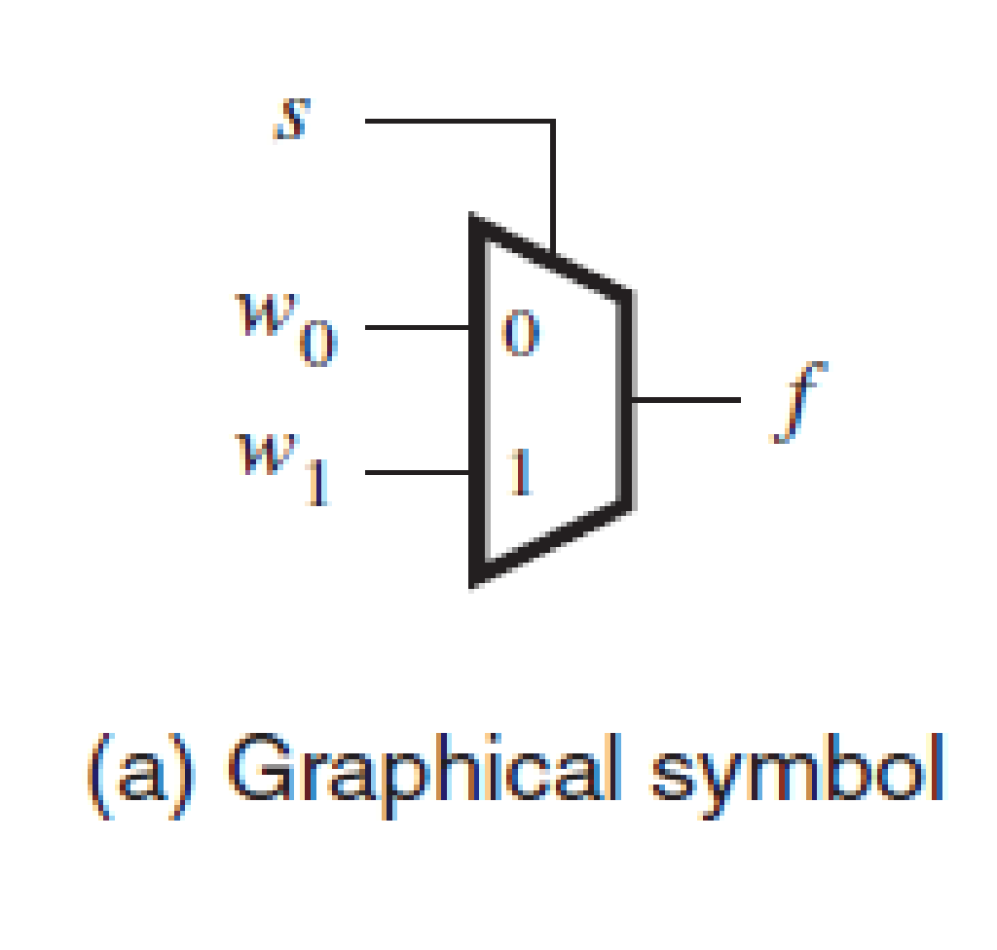
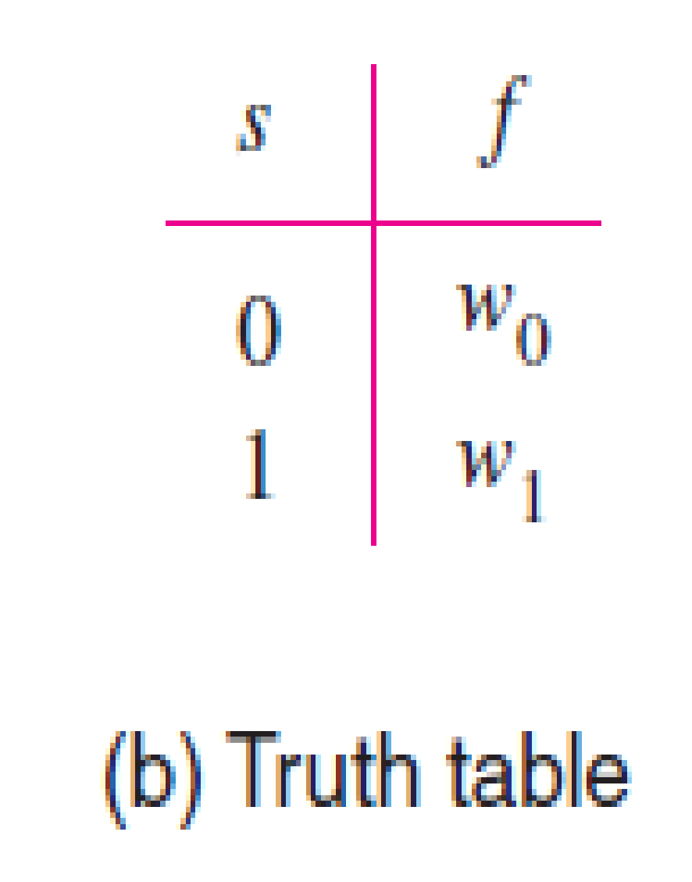
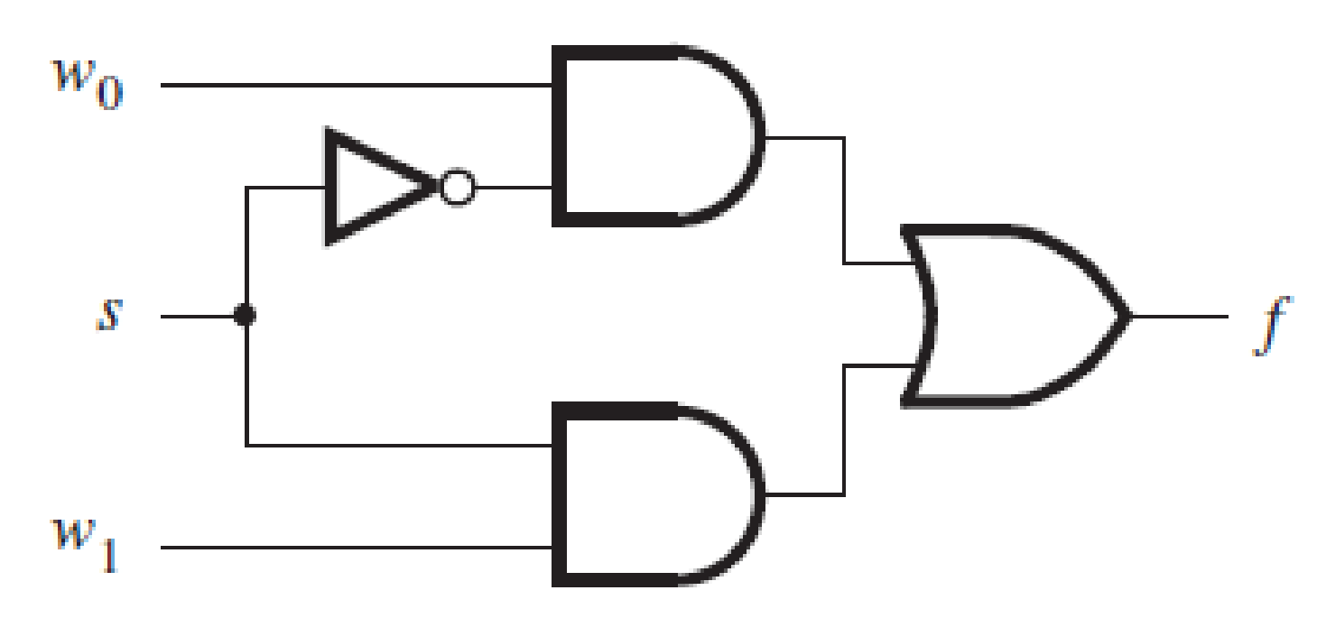
2-to-1 multiplexer.

Slide 3
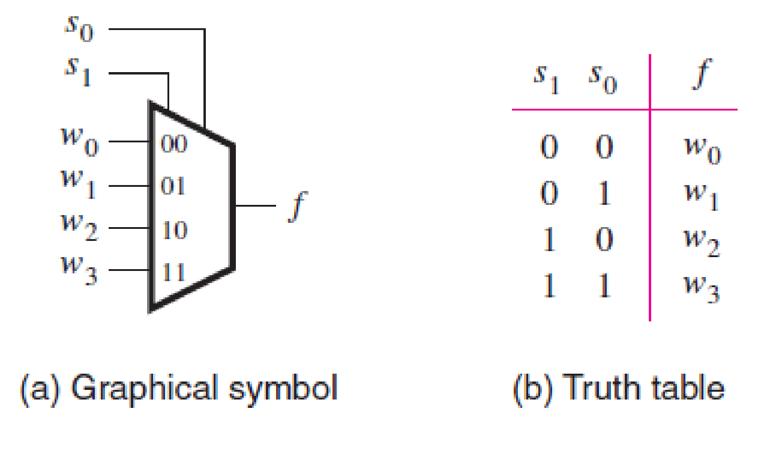
4-to-1 multiplexer.

Slide 4
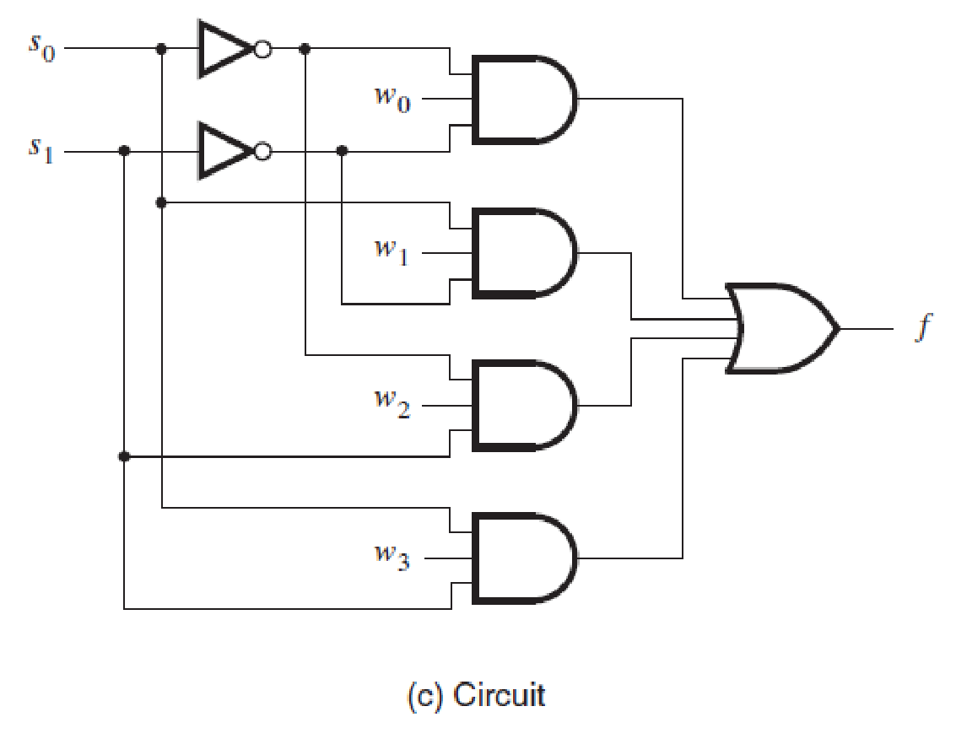
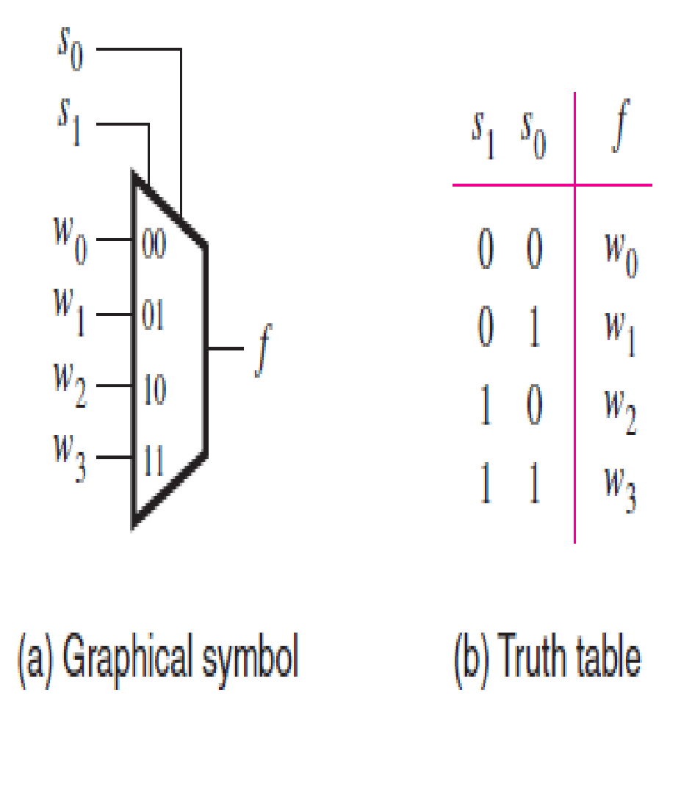

Slide 5

Usually, the number of data inputs, n, is an integer power of two. A multiplexer that has n data inputs,
w0, . . . ,wn−1, requires select inputs and it has one output.
Larger multiplexers can also be constructed from smaller multiplexers. For example, the 4-to-1 multiplexer can be built using three 2-to-1 multiplexers as shown below:

Slide 6
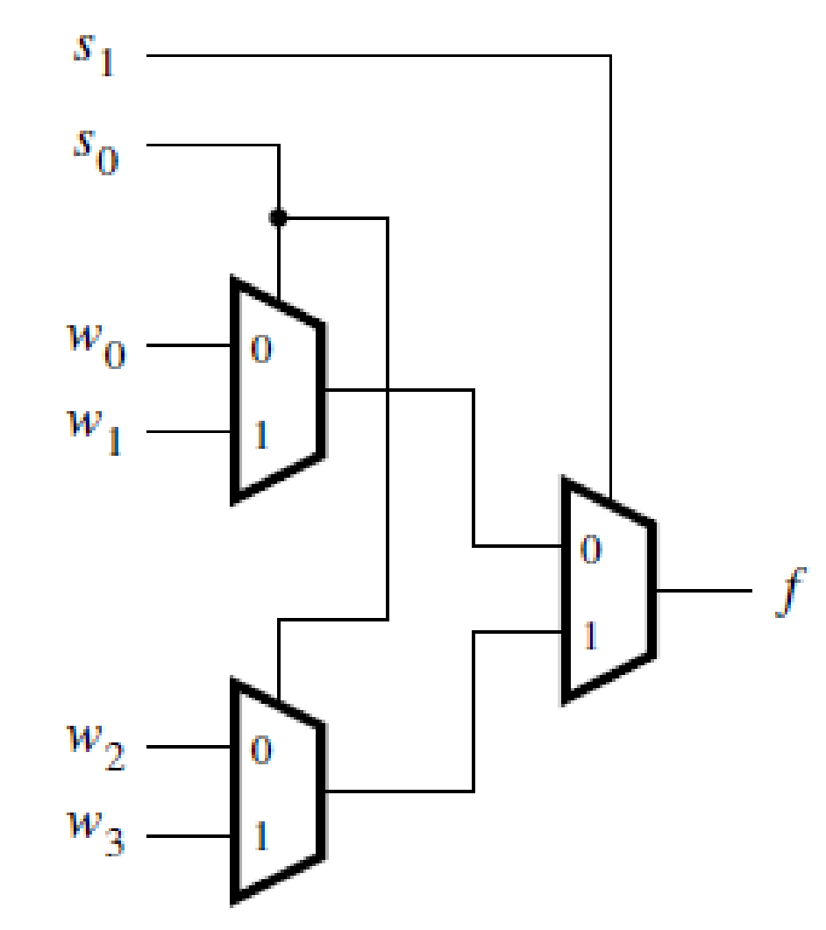
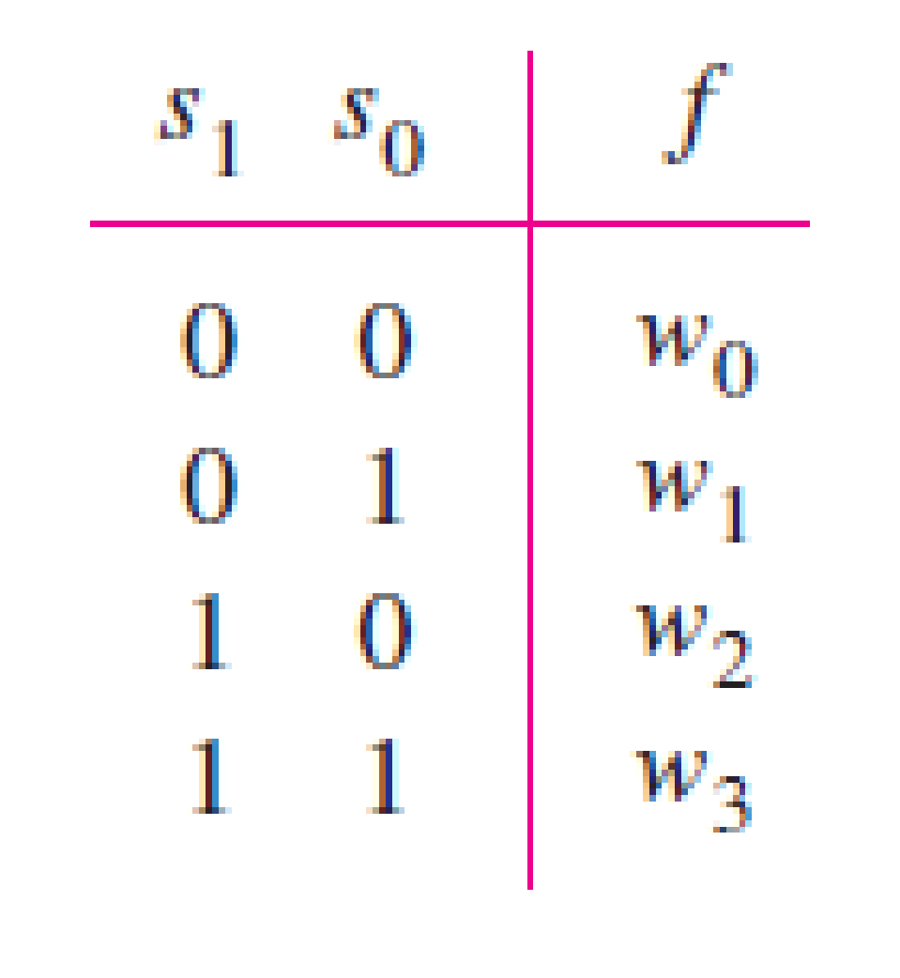
Using 2-to-1 multiplexers to build a 4-to-1 multiplexer.

Slide 7
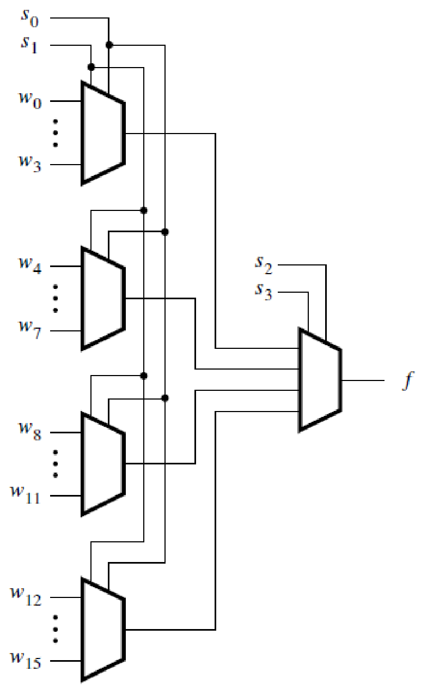
Similarly, 16-to-1 multiplexer can be constructed with five 4-to-1 multiplexers.

Slide 8
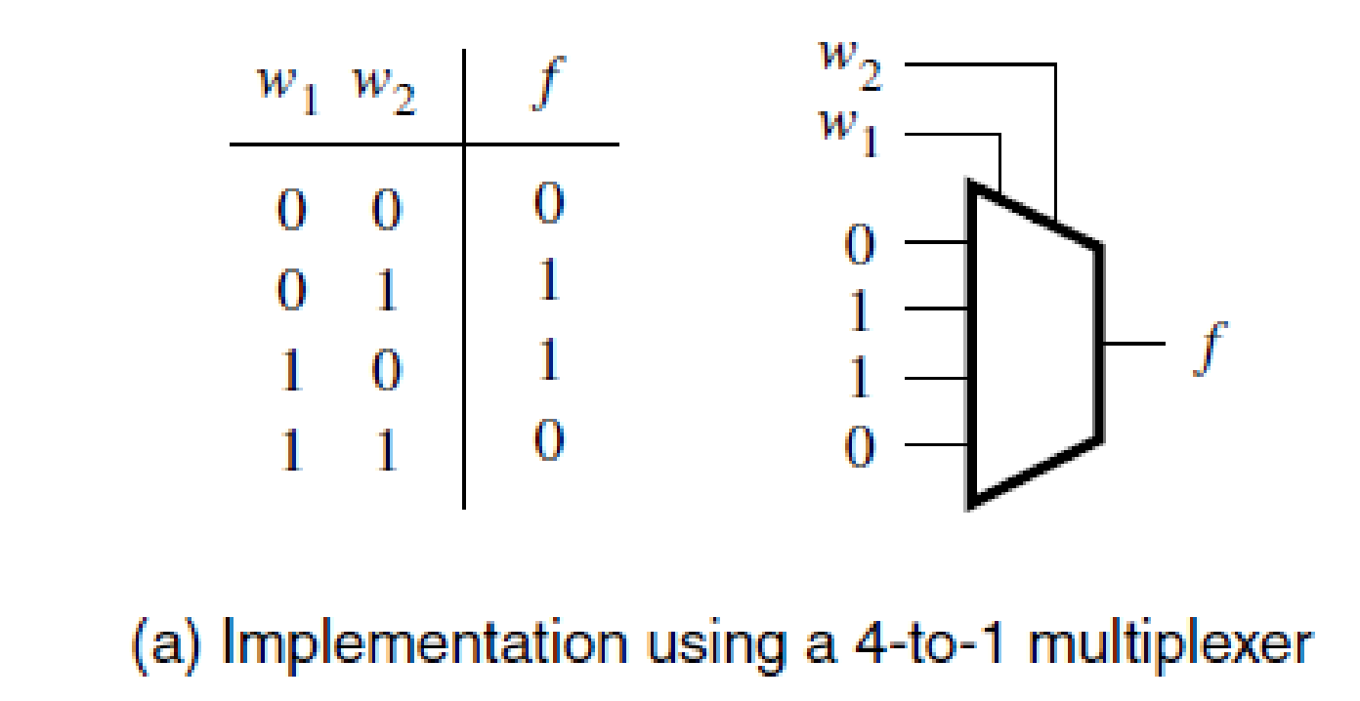
Synthesis of Logic Functions Using Multiplexers

Slide 9
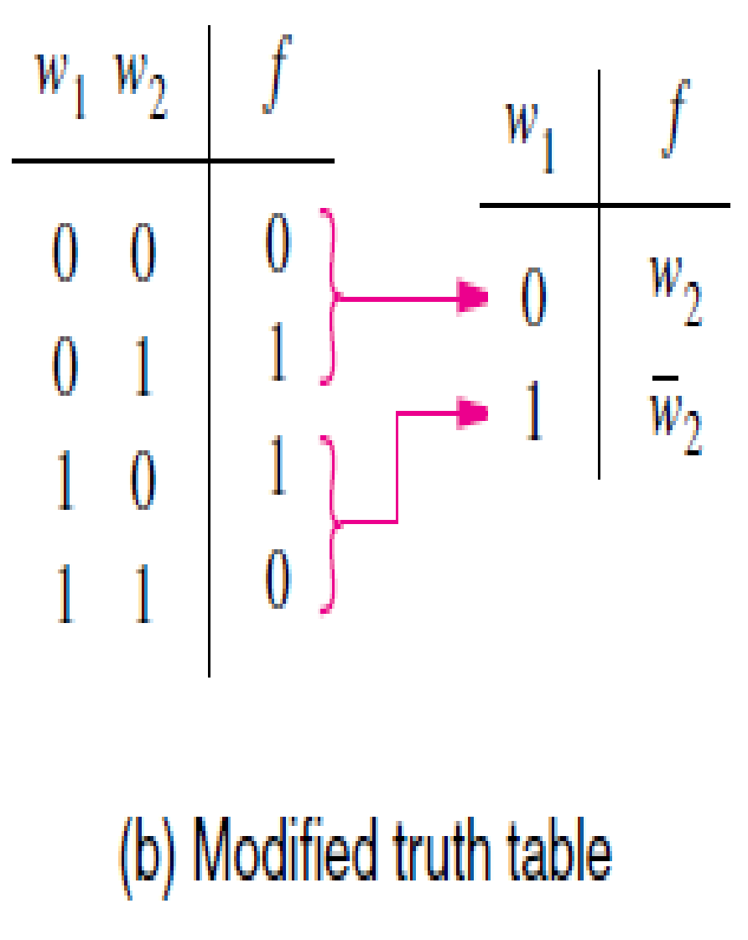
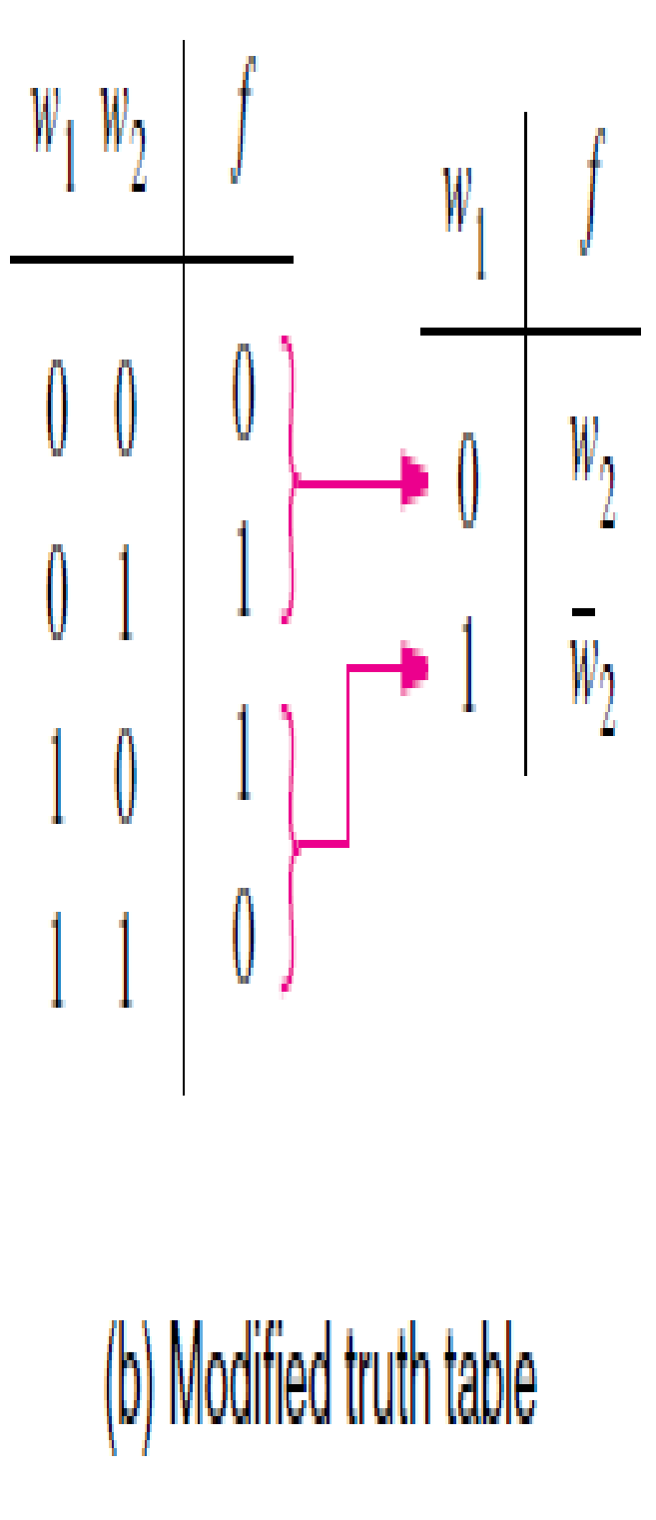
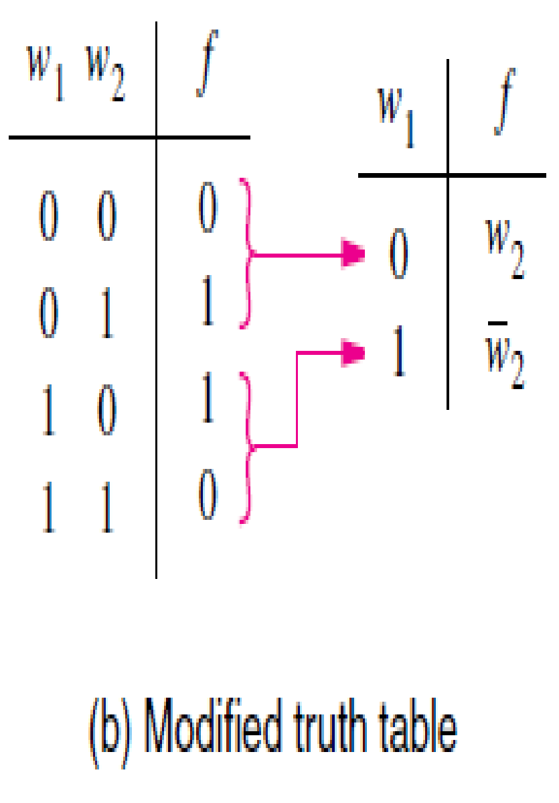
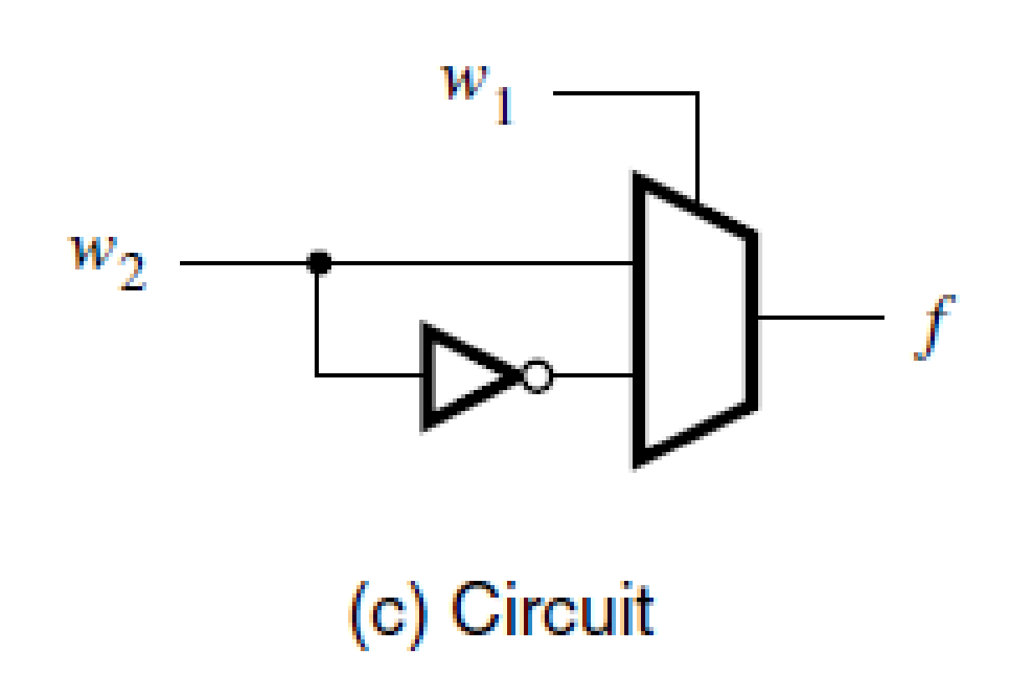
Example 1 : Two input XOR function using 2 to 1 multiplexer

Slide 10
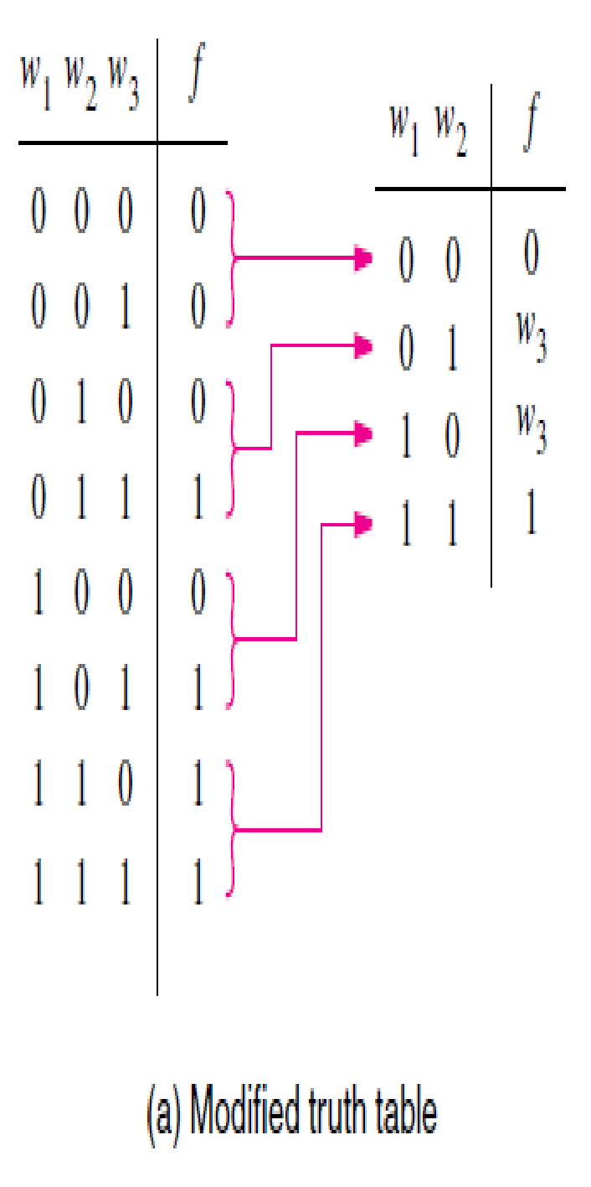
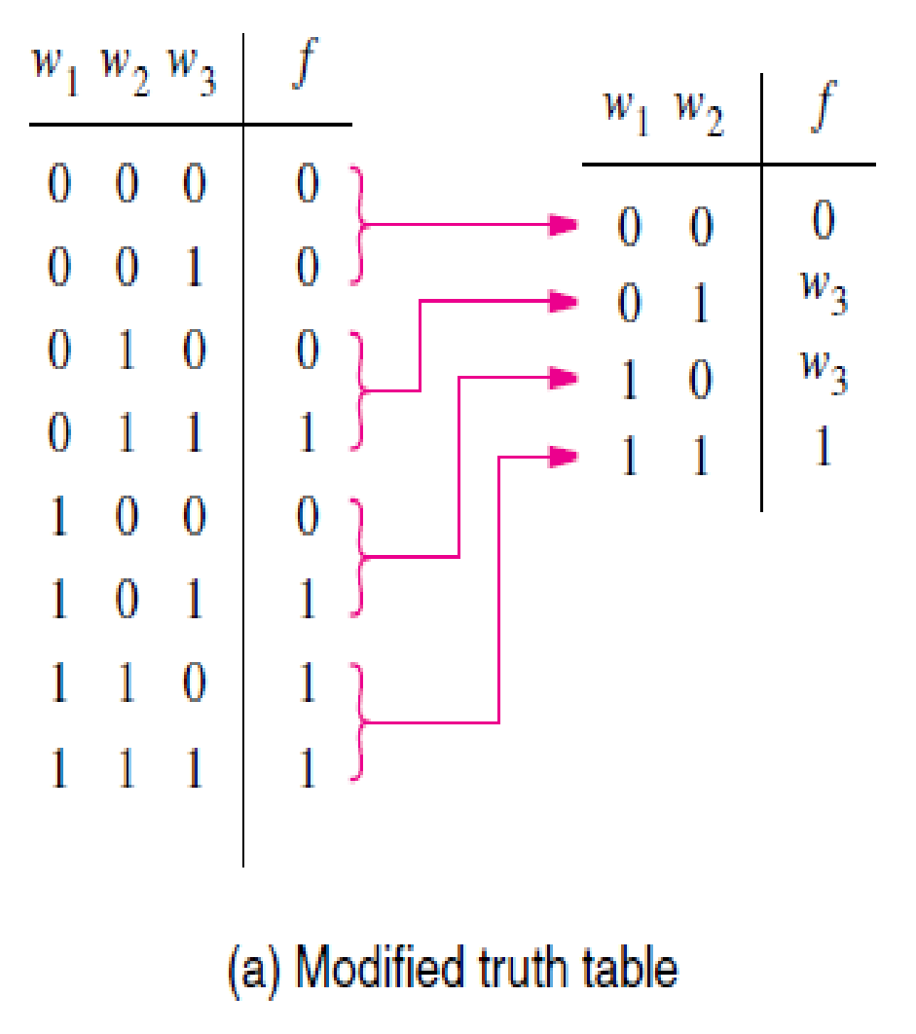
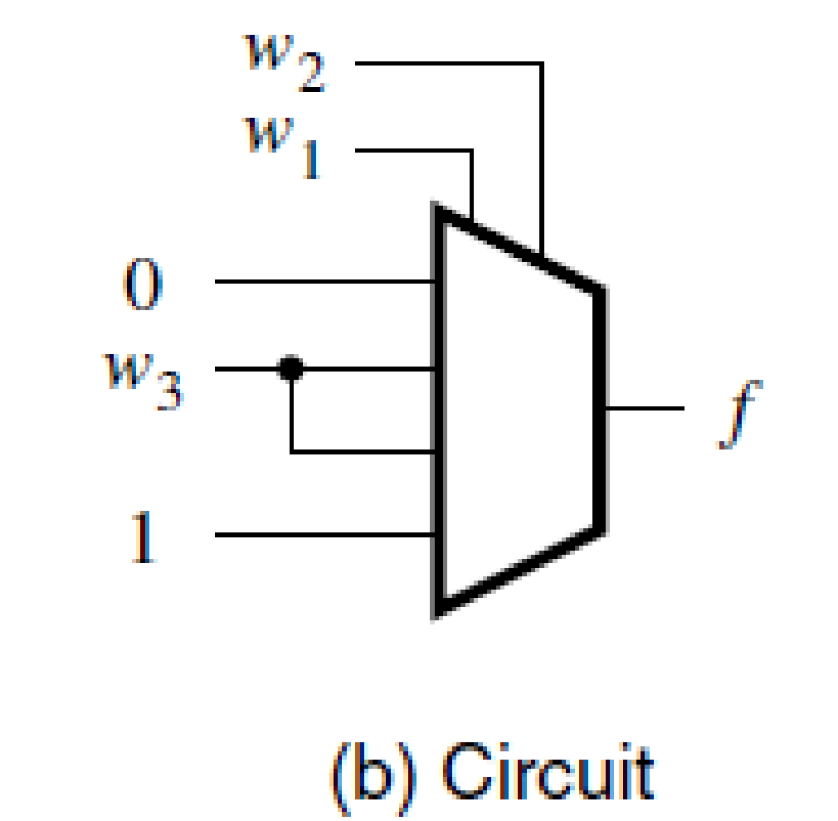
Example 2 : Three input majority function using 4 to 1 multiplexer

Slide 11
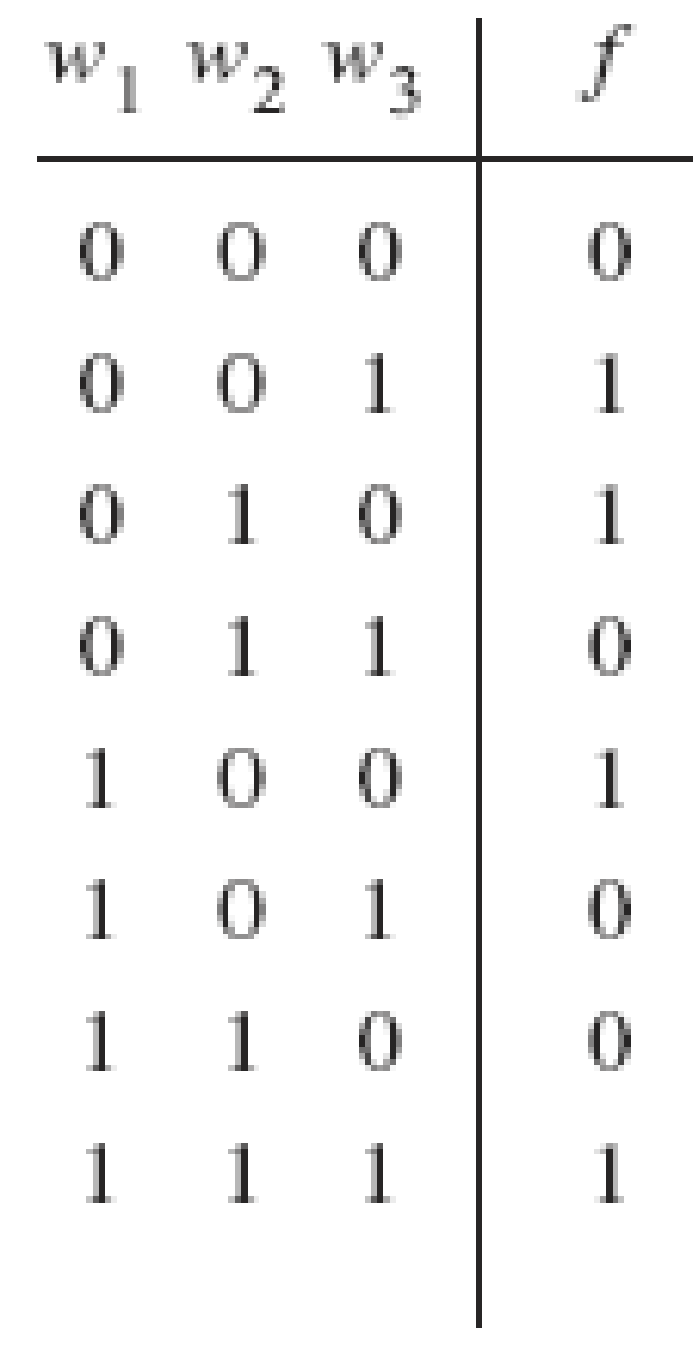
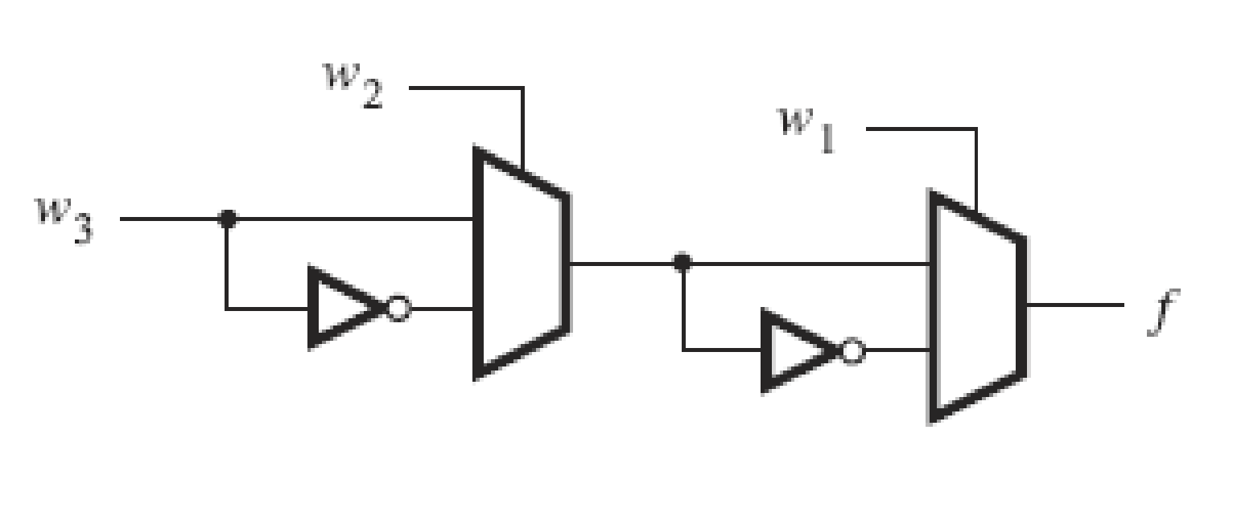
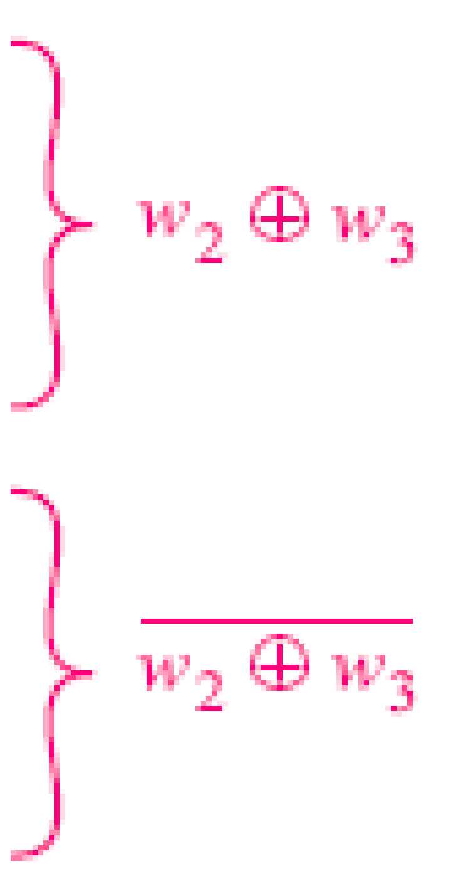


Example 3: Implement a three-input XOR gate using 2-to-1 multiplexer.

Slide 12
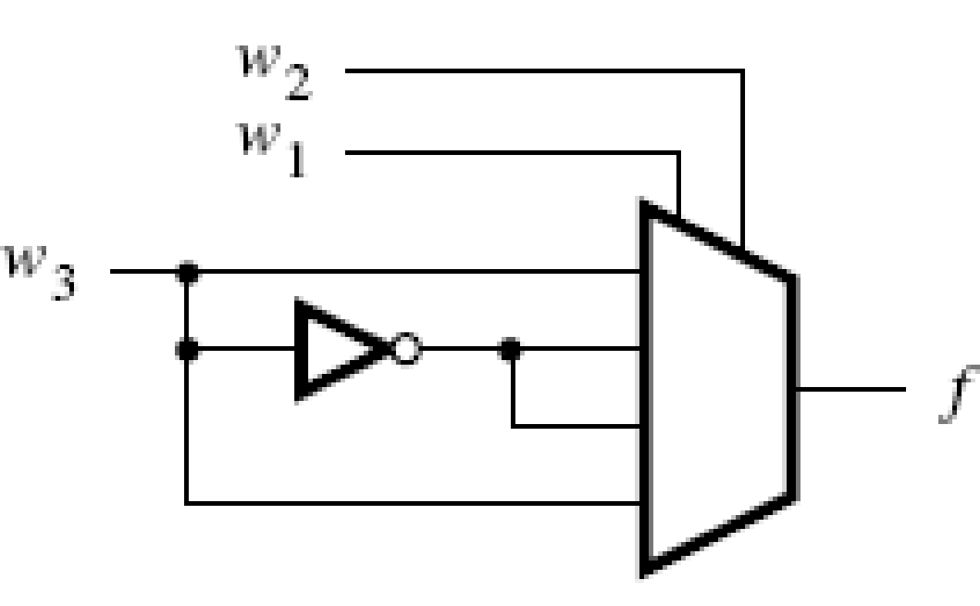
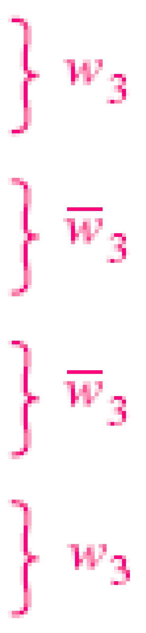
Example 4: Implement a three-input XOR gate using 4-to-1 multiplexer.

Slide 13
Multiplexer Synthesis Using Shannon’s Expansion
The inputs to the multiplexers are the constants 0 and 1, or some variable or its complement. Besides using such simple inputs, it is
possible to connect more complex circuits as inputs to a multiplexer, allowing functions to be synthesized using a combination of multiplexers and other logic gates.

Slide 14
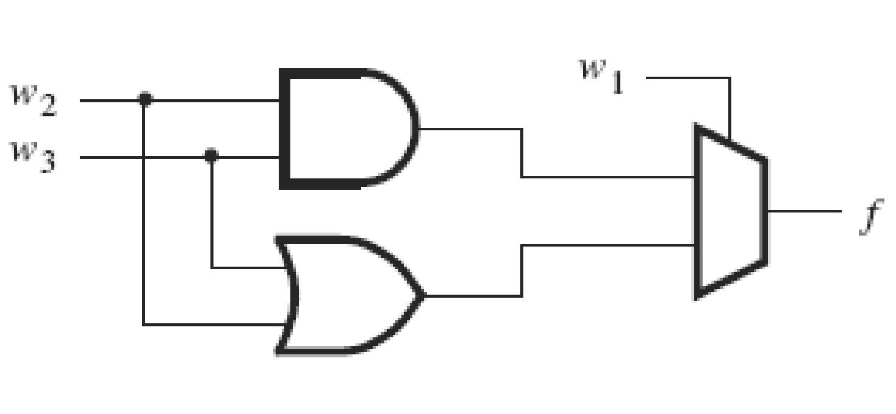

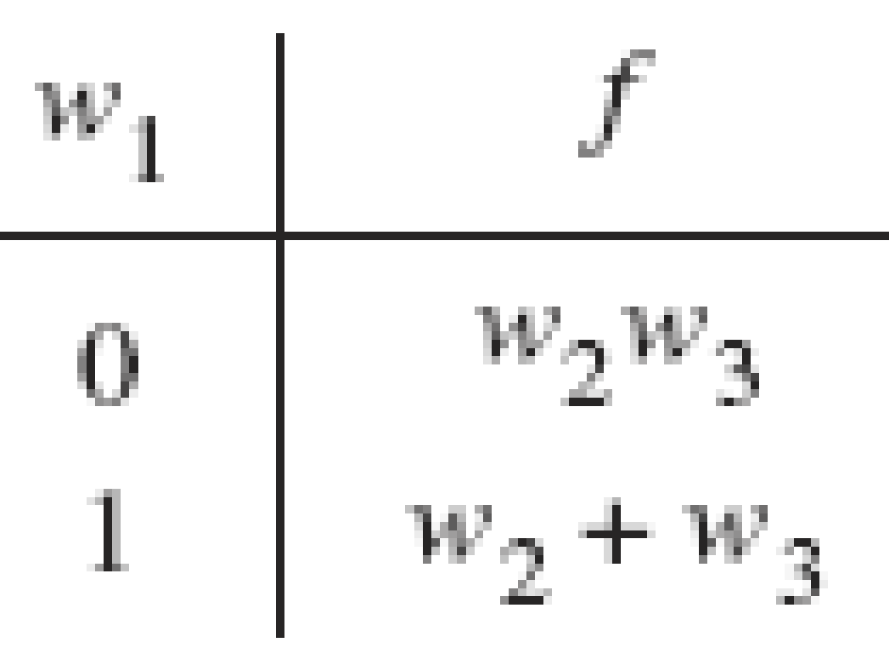
Example 5 : Three input majority function using 2 to 1 multiplexer
w₂w₃
w₂+w₃

Slide 15
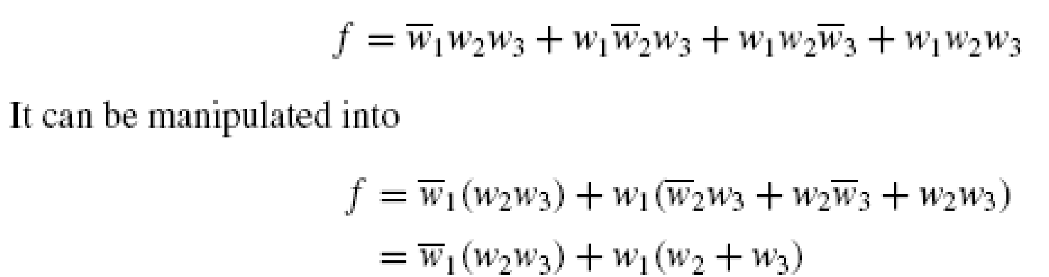
Shannon’s Expansion
This implementation can be derived using algebraic manipulation as follows. The function is expressed in sum-of-products form as
Multiplexer implementations of logic functions require that a given function be decomposed in terms of the variables that are used as the select inputs. This can be accomplished by means of a theorem proposed by Claude Shannon

Slide 16
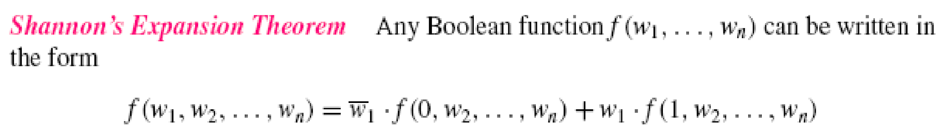
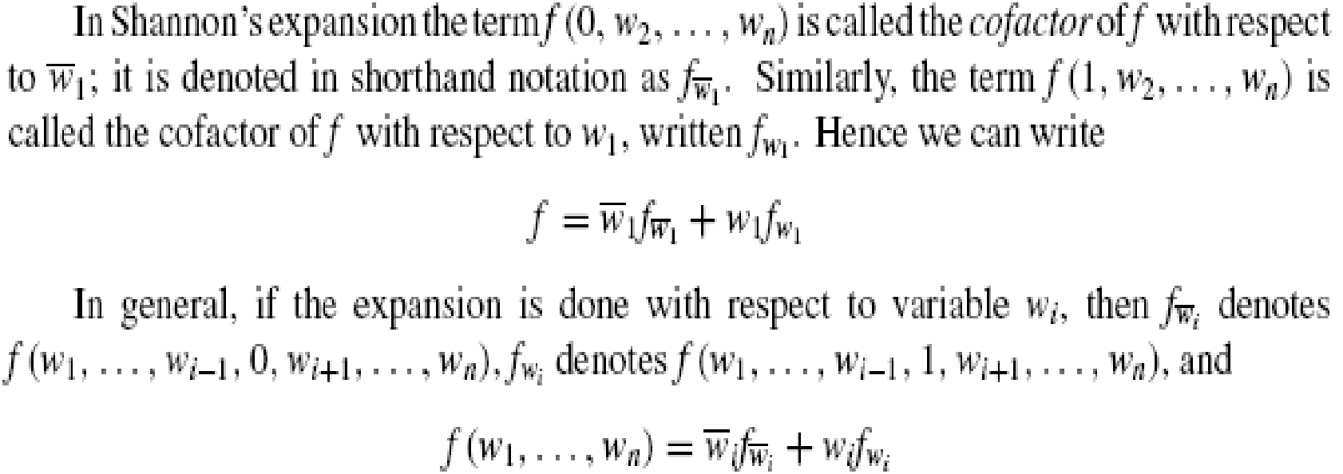

Slide 17
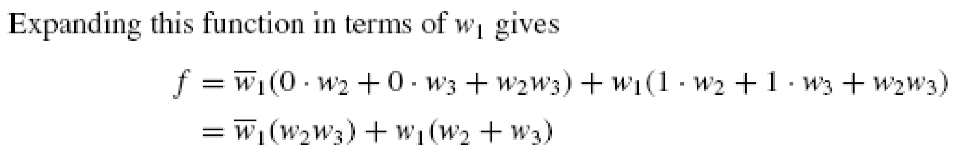
Example 1

Slide 18
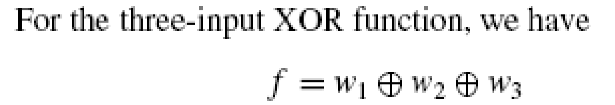
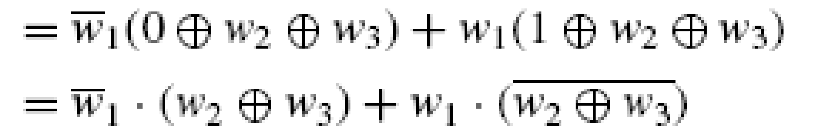
Example 2

Slide 19
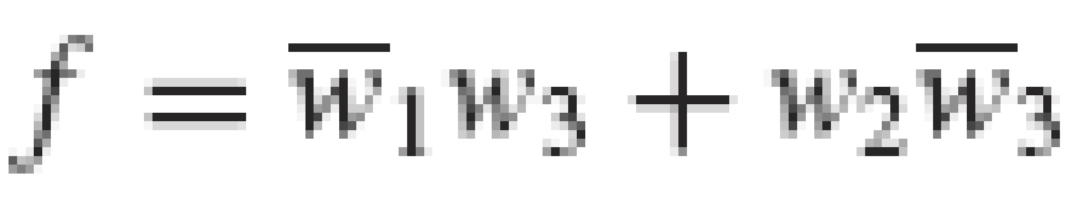
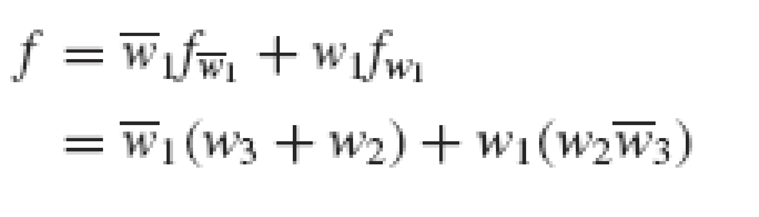
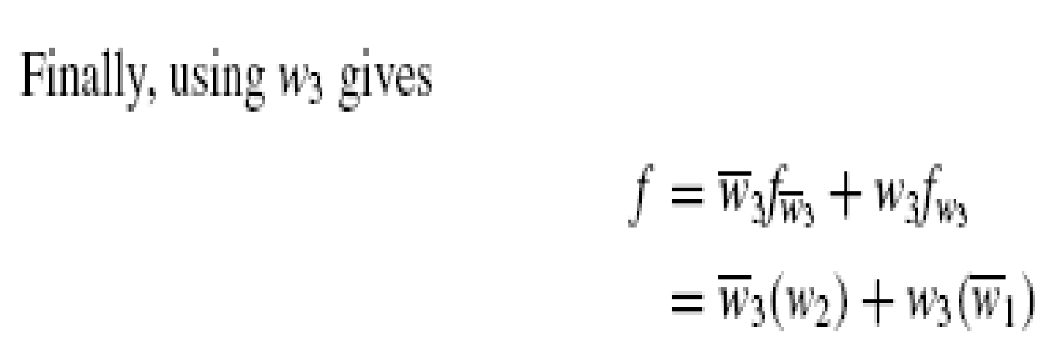
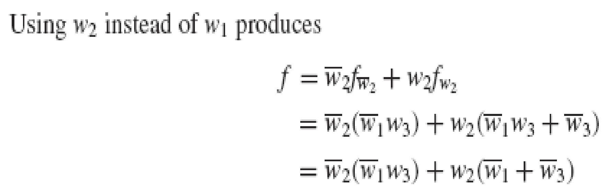
Example 3
Decomposition using w₁ gives
Decomposition using w₃ gives
Using w₂ instead of w₁ gives

Slide 20
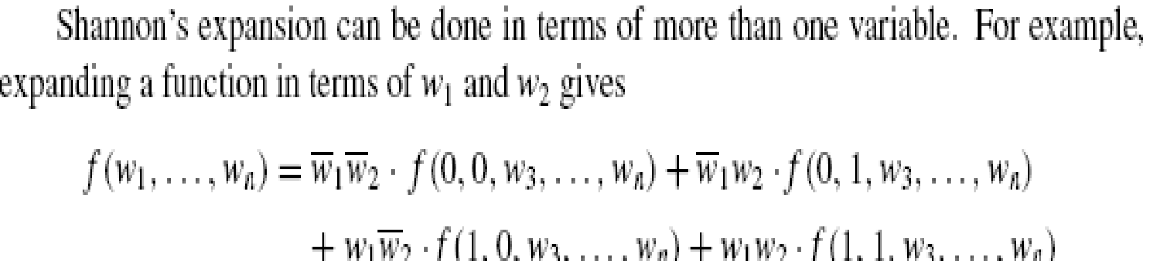

Slide 21
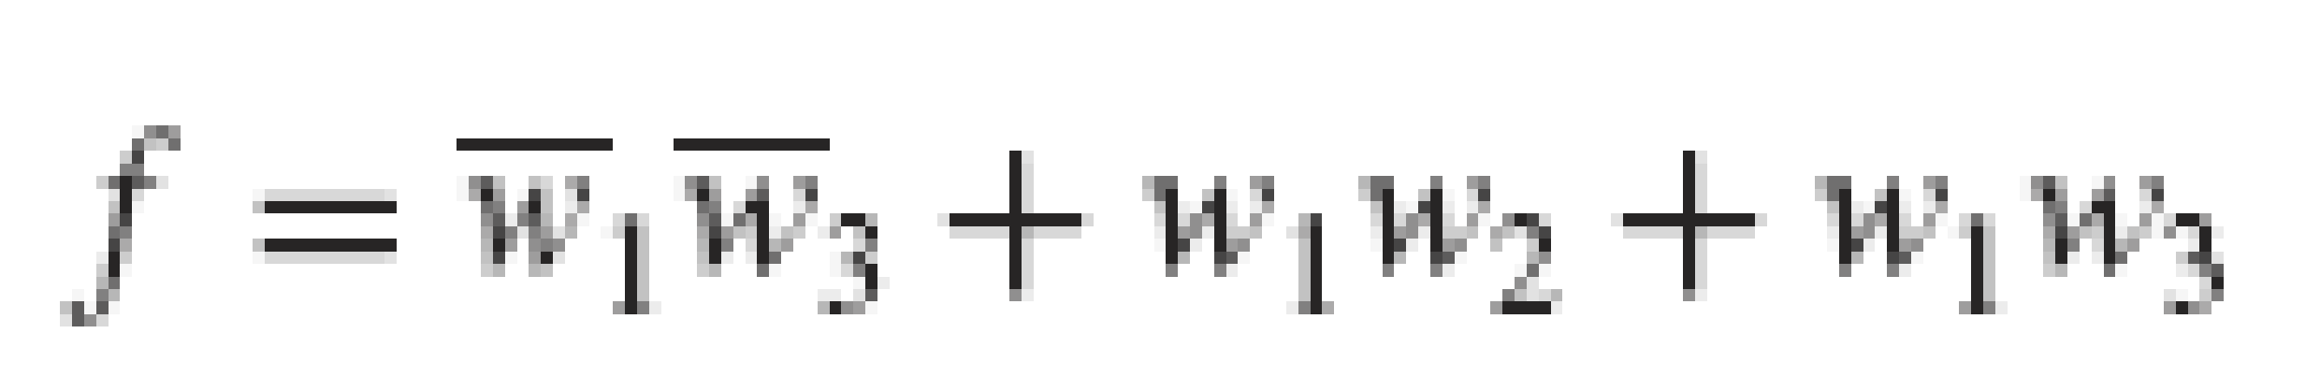
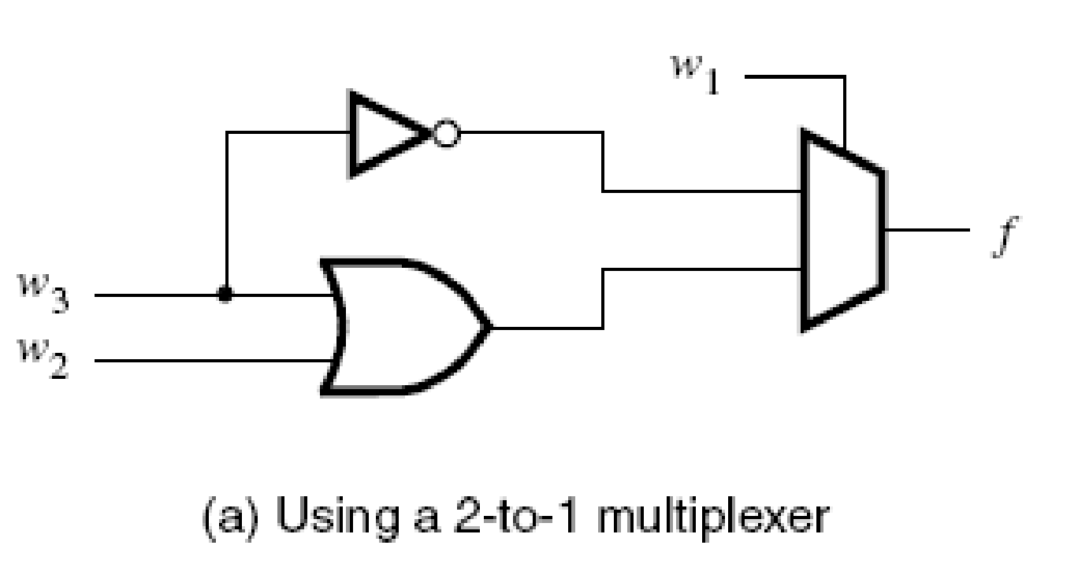
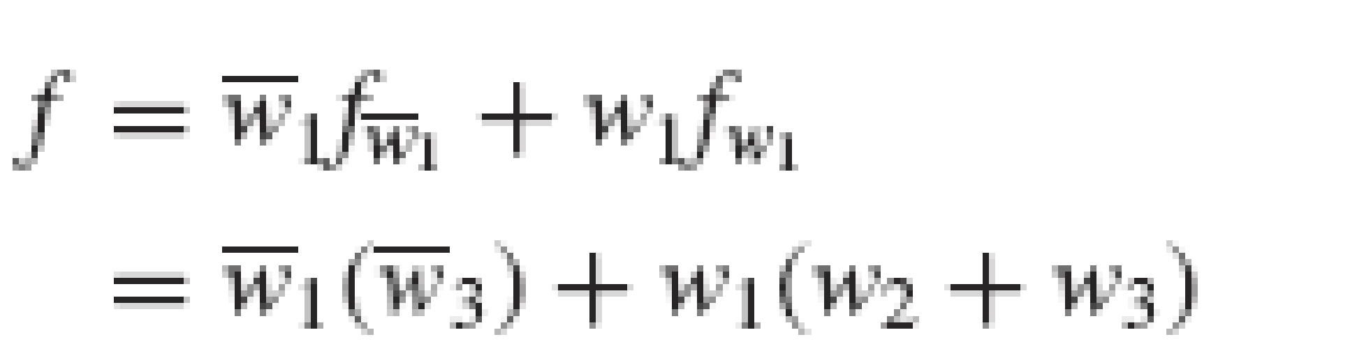
Example 4: Implement the following function using
2-to-1 multiplexers
4-to-1 multiplexers
and any other necessary gates
Shannon’s expansion using w₁ gives

Slide 22
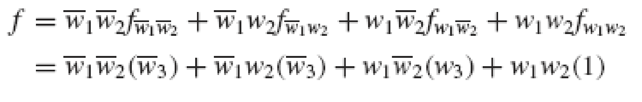
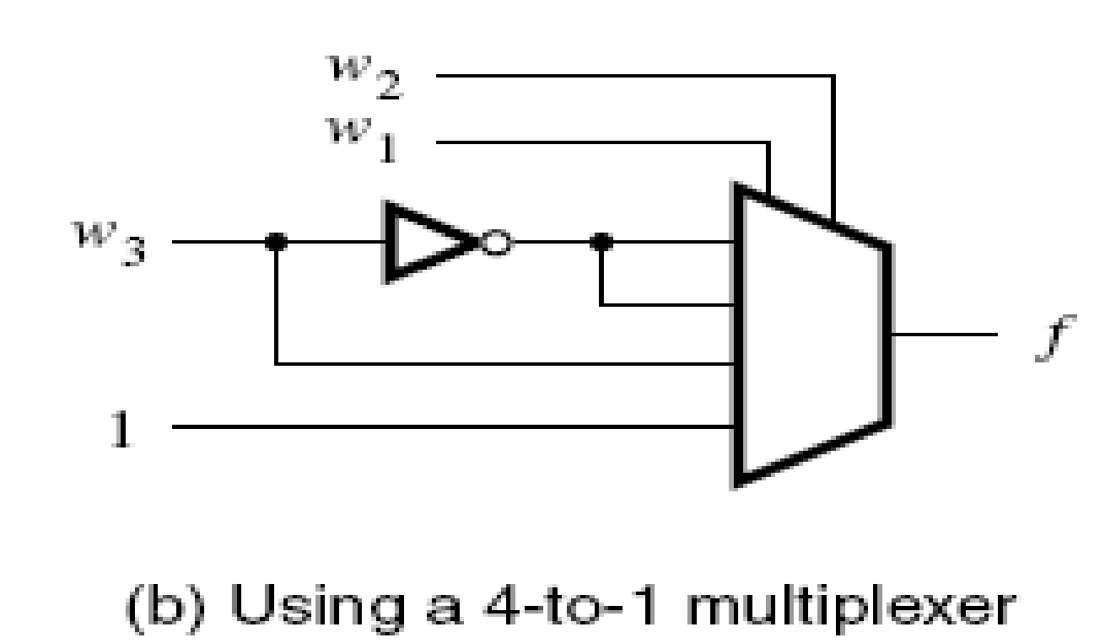
Example 4 (Contd…)
Shannon’s expansion using both w₁ and w₂ gives

Slide 23
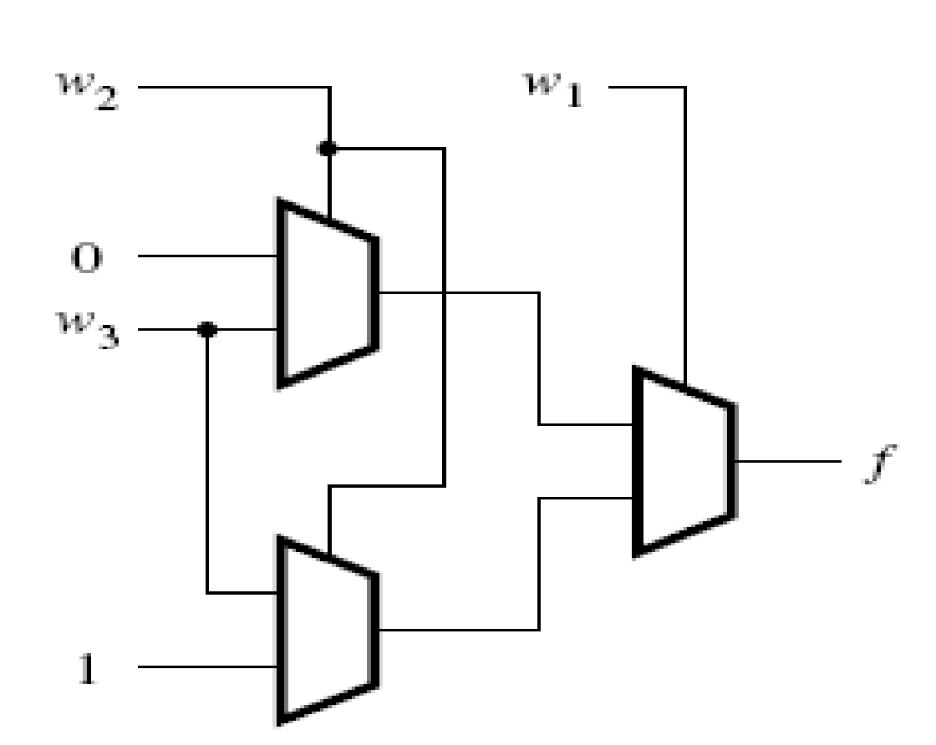
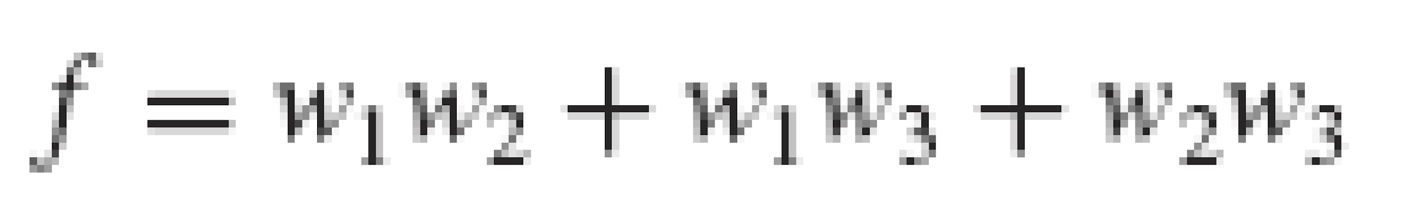
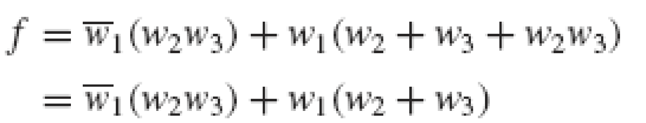
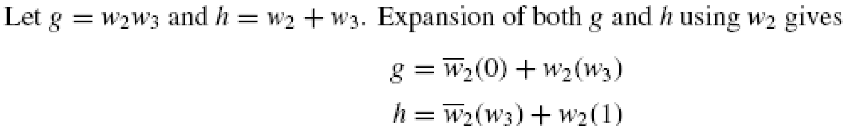
Example 5: Implement the following function using only 2-to-1 multiplexers
Shannon’s expansion using w₁ gives

Slide 24
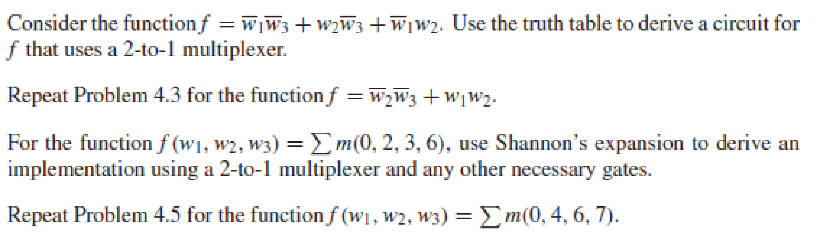

Slide 25
Decoders
A binary decoder is a logic circuit with n inputs and 2^{n} outputs.
Only one output is asserted at a time, and each output corresponds to one valuation of the inputs.
The decoder also has an enable input En
If En=1, the valuation of w_{n-1}…w₁w₀ determines which of the outputs is asserted.
If En=0, then none of the decoder outputs is asserted.

Slide 26
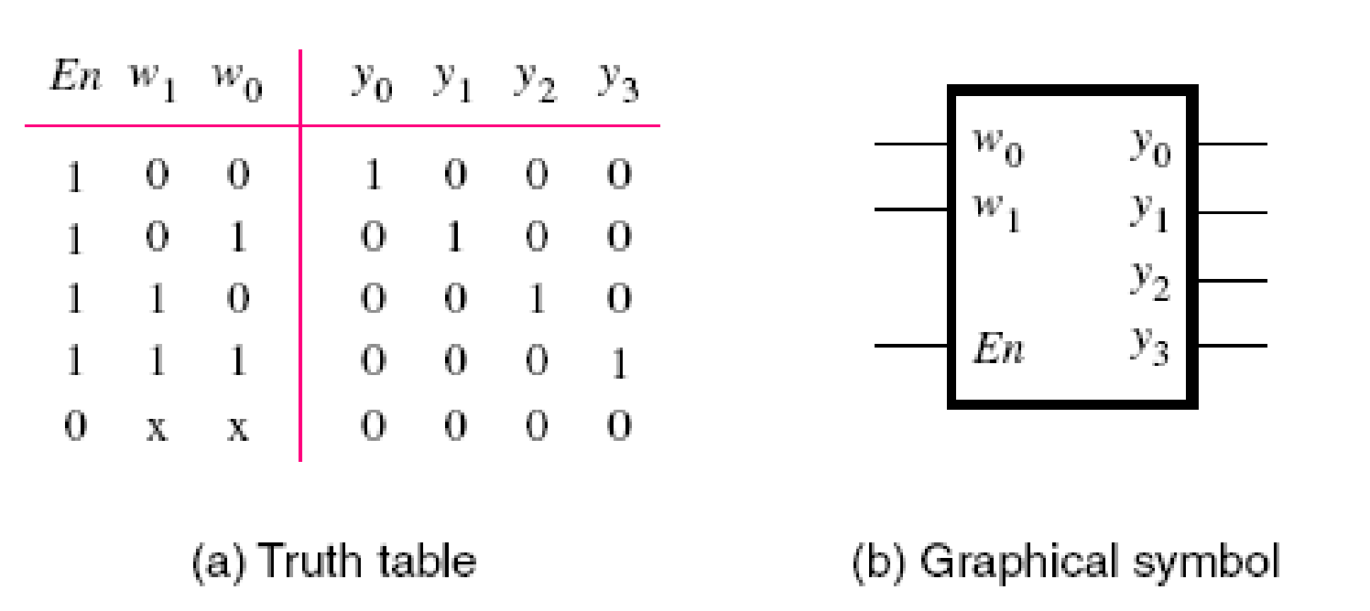
2-to-4 Decoders

Slide 27
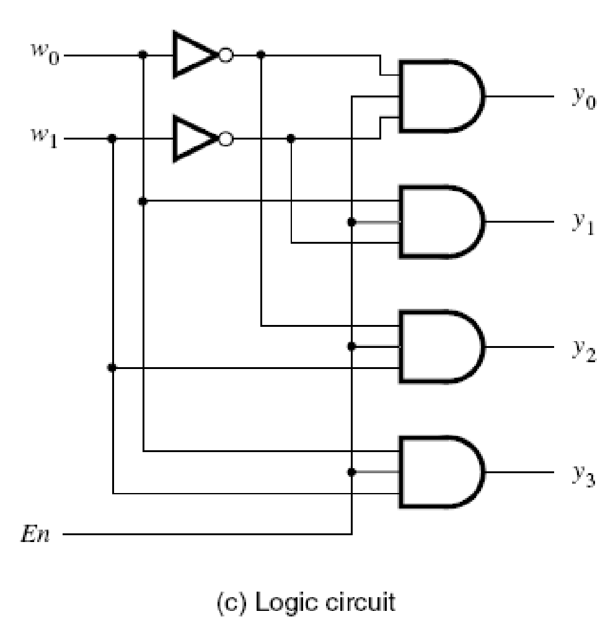
2-to-4 Decoders

Slide 28
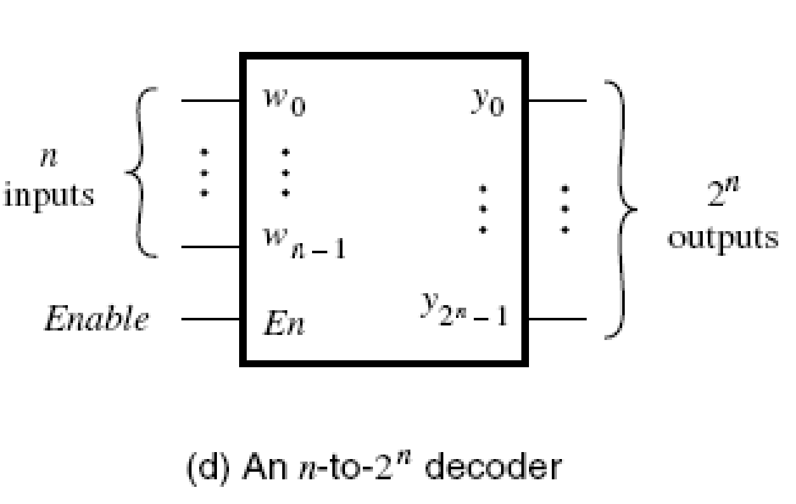
Decoders

Slide 29
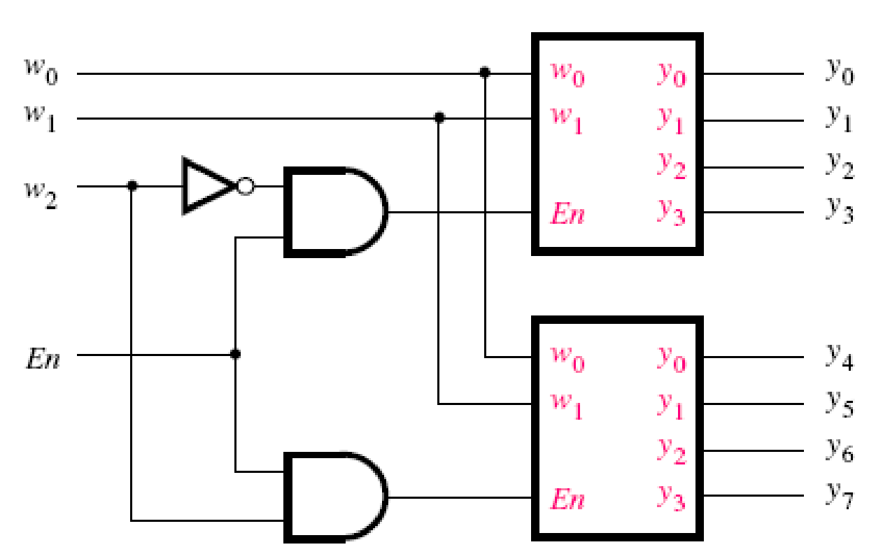
Decoders
Larger decoders can be built using the sum-of-products structure or else they can be constructed from smaller decoders.
The w2 input drives the enable input of the two decoders.

Slide 30
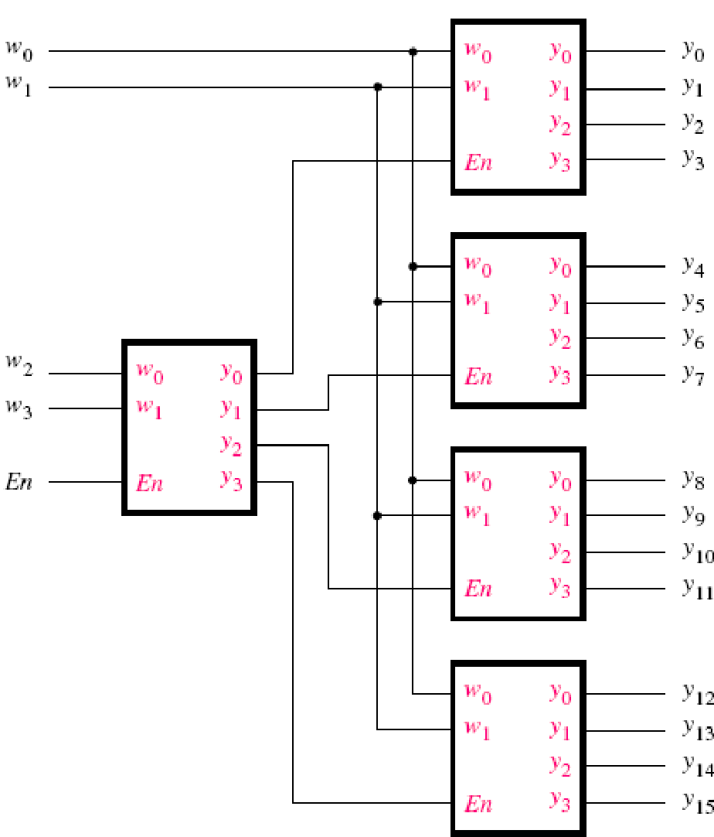
4-to-16 Decoder
This type of circuit is referred to as a decoder tree.

Slide 31


4-to-1 Multiplexer using Decoder
4-to-1 Multiplexer
4-to-1 Multiplexer using decoder

Slide 32


Encoders
Binary Encoders
Exactly one of the input signals should have a value of 1, and the outputs present the binary number that identifies which input is equal to 1.

Slide 33


4-to-2 Binary Encoders
The inputs are one-hot encoded. The input patterns that have multiple inputs set to 1 are treated as don’t care conditions.
Encoders are used for transmitting information in a digital system.

Slide 34




Priority Encoders
In a priority encoder each input has a priority level associated with it.
The encoder outputs indicate the active input that has the highest priority.
When an input with high priority is asserted, the inputs with lower priority are ignored.
Z is set to 1 when atleast one of the inputs is equal to 1.

Slide 35
Priority encoder having w0 highest priority and w3 least priority
w3 w2 w1 w0 y1 y0 z
x x x 1 0 0 1
x x 1 0 0 1 1
x 1 0 0 1 0 1
1 0 0 0 1 1 1
0 0 0 0 x x 0

